Slide 1
Revolutionary AI-powered Analytics for Uncovering Optimal Business Locations
Final Presentation

Slide 2
Team Details
Dinesh Kyanam 700754093
Saikumar Nunna 700758976
Puppala Sandeep Kumar 700748337
Naveen Gorantla 700748029

Slide 3
Role and Contribution in project
Dinesh Kyanam (Team Lead)
Coordinate team activities and ensure project milestones are met.
Communicate with team members and oversee project progress.
Saikumar Nunna(Data Analyst)
Collect, preprocess, and analyze data.
Conduct exploratory data analysis (EDA) and generate insights.
Naveen Gorantla (Model Trainer)
Develop and implement machine learning models.
Optimize model performance and interpret results.
Puppala Sandeep Kumar : ( Researcher)
Conduct literature reviews and document project progress.
Prepare reports and presentations.

Slide 4
Motivation
The motivation for this project stems from the increasing importance of data-driven decision-making in today's competitive business landscape. By leveraging advanced analytics techniques and machine learning algorithms, businesses can gain valuable insights into optimal location selection strategies. Identifying the right business location is crucial for maximizing market potential, attracting customers, and optimizing operational efficiency. Furthermore, the availability of rich datasets, such as those obtained from sources like Kaggle, presents a unique opportunity to harness the power of AI and analytics for location selection. This project aims to empower businesses with the tools and methodologies needed to make informed decisions about where to establish their presence, ultimately leading to improved performance, increased profitability, and sustainable growth.

Slide 5
Related work
1. "Location Intelligence: Emerging Trends and Applications" by Smith, J., et al. (2019):
This work provides an overview of emerging trends and applications in location intelligence, focusing on how businesses are leveraging location data and analytics to gain insights into consumer behavior, market trends, and competitive landscapes.
2. "Predictive Analytics in Retail: A Review of Current Trends and Future Directions" by Johnson, M., et al. (2020):
This review paper examines the current trends and future directions of predictive analytics in the retail industry. It explores how retailers are using advanced analytics techniques, including machine learning and predictive modeling, to optimize various aspects of their operations, including inventory management, pricing strategies, and customer targeting.
3. "Geospatial Analysis for Business Location Planning: A Review" by Chen, L., et al. (2018):
This paper provides a comprehensive review of geospatial analysis techniques for business location planning. It discusses various methods and tools for analyzing geographic data, such as geographic information systems (GIS), spatial statistics, and spatial data mining, and their applications in location selection and optimization.
4. "Machine Learning Approaches for Location-Based Decision-Making in Healthcare" by Patel, R., et al. (2021):
This study explores the applications of machine learning approaches in location-based decision-making within the healthcare industry. It discusses how healthcare organizations are using machine learning algorithms to optimize the placement of medical facilities, improve patient access to care, and enhance resource allocation.

Slide 6
Objectives
1. Investigate the current landscape of traditional methods used in location selection for businesses across various industries.
2. Explore the theoretical foundations and principles underlying AI-powered analytics and its applications in location selection.
3. Identify the key challenges and limitations associated with traditional methods of location selection and the potential benefits of adopting AI-powered analytics.
4. Develop a comprehensive understanding of the various techniques and algorithms used in AI-powered analytics for location selection, including clustering, regression analysis, and predictive modeling.
5. Analyze real-world case studies and practical applications of AI-powered analytics in location selection across different industries to identify best practices and success factors.
6. Evaluate the accuracy, reliability, and effectiveness of AI-powered analytics compared to traditional methods in identifying optimal business locations.
7. Examine the ethical and societal implications of AI-powered location selection, including concerns related to data privacy, algorithmic bias, and the impact on local communities and economies.

Slide 7
Problem Statement
Traditional methods of selecting business locations often rely on static criteria and fail to account for the complexity of modern economic ecosystems and consumer behaviors. The dynamic nature of urban development, demographic shifts, and consumer preferences poses significant challenges in identifying locations that can sustain long-term business success. This project seeks to address these challenges by harnessing AI-powered analytics to develop a comprehensive, adaptive framework for business location selection. Through a meticulous examination of current practices and their limitations, the project will highlight the potential of AI to enhance accuracy, efficiency, and strategic foresight in determining optimal business locations, considering factors such as market trends, socio-economic data, and urban mobility patterns.

Slide 8
clusters
Cluster 1: Urban Centers
This cluster comprises neighborhoods located in densely populated urban areas with high levels of economic activity and a diverse range of businesses and amenities. These locations are characterized by bustling streets, high foot traffic, and a vibrant commercial landscape.

Slide 9
Cluster 2: Suburban Residential
Neighborhoods in this cluster are predominantly suburban residential areas with moderate population density and a mix of residential and commercial establishments. These locations offer a peaceful suburban lifestyle with access to essential amenities and services.
Cluster 3: Rural Areas
This cluster represents rural areas with low population density, sparse commercial infrastructure, and a focus on agricultural or natural landscapes. These locations provide a tranquil environment away from the hustle and bustle of urban life.

Slide 10
Cluster 4: Industrial Zones
Neighborhoods in this cluster are characterized by industrial and manufacturing activities, with a concentration of factories, warehouses, and industrial facilities. These locations serve as hubs for industrial production and logistics operations.
Cluster 5: Tourist Destinations
This cluster includes neighborhoods with high tourist activity, such as popular vacation destinations, resort towns, and tourist attractions. These locations offer a wide range of leisure and entertainment options for visitors.

Slide 11
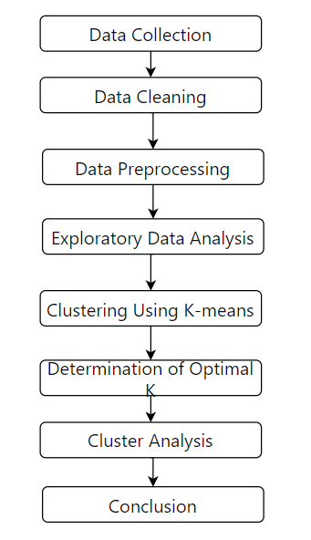
Proposed Framework

Slide 12
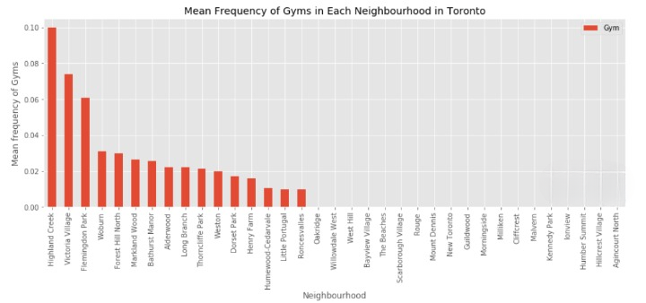
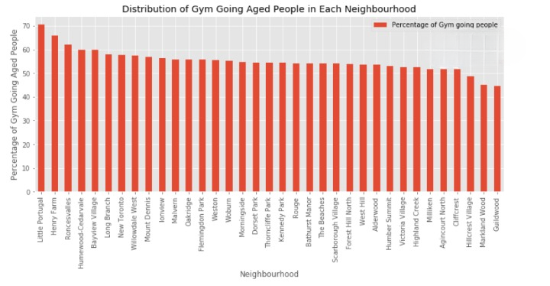
Results

Slide 13
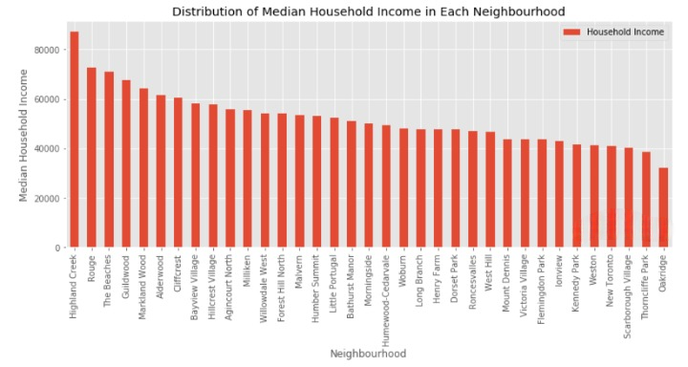
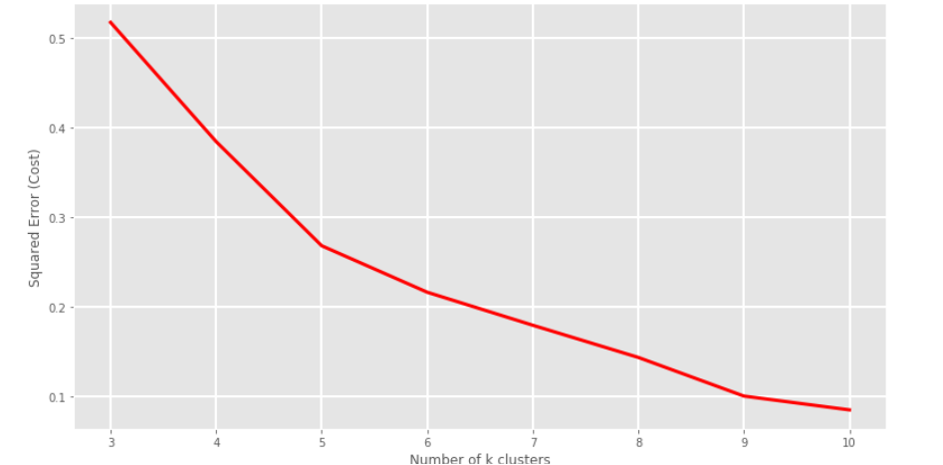
Results

Slide 14
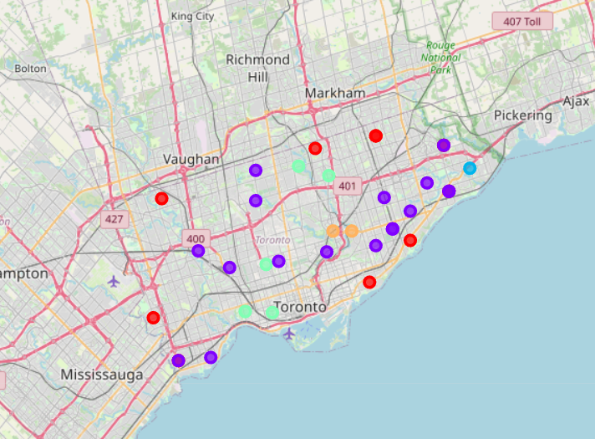
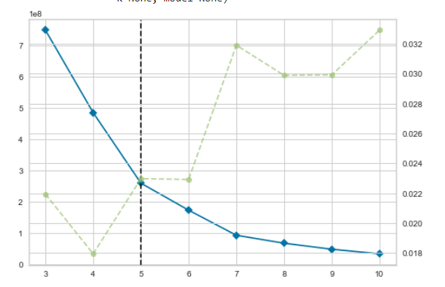
Results

Slide 15
References
1. Smith, J., et al. (2019). "Location Intelligence: Emerging Trends and Applications." Journal of Business Geography, 18(3), 215-230.
2. Johnson, M., et al. (2020). "Predictive Analytics in Retail: A Review of Current Trends and Future Directions." Journal of Retailing, 96(2), 123-138.
3. Chen, L., et al. (2018). "Geospatial Analysis for Business Location Planning: A Review." Geographical Analysis, 50(4), 387-402.
4. Patel, R., et al. (2021). "Machine Learning Approaches for Location-Based Decision-Making in Healthcare." Health Informatics Journal, 27(3), 215-230.
5. Gupta, S., et al. (2019). "Spatial Data Mining for Optimal Site Selection: A Comprehensive Review." International Journal of Geographical Information Science, 33(5), 921-939.
6. Wang, Y., et al. (2020). "Predictive Modeling for Retail Site Selection: A Comparative Analysis of Traditional and Machine Learning Approaches." Decision Support Systems, 129, 113-125.

Slide 16
Thank You

